Slide 1
Stack vs Heap
How they relate to memory

Slide 2
Stack in different situations
Stack could mean:
A last-in, first-out data structure
class Stack{}; (More on this later)
A list of functions currently executing in a program
The call stack
A location in memory tracking stack frames
i.e The Stack, part of the amazing duo, Stack and Heap

Slide 3
The Stack - Summary
The stack is a small chunk of memory that keeps track of “stack frames”
A stack frame is a chunk of memory that contains the information necessary to execute a function:
Memory for variables created in that function
Memory for passed-in parameters
Memory address of previous stack frame
The ordering of a stack is last-in, first-out
Think of a stack of papers or books, or a deck of cards—last one “in” the stack (i.e. on top) is the first to go “out”
6th item added to the stack, first one to be removed
1st item added to the stack, last item to be removed

Slide 4
Call Stack Example
int main()
{
Initialize(1280, 720);
Run();
return 0;
}
Initialize(1280, 720)
main()

Slide 5
Initialize() executes…
When this function is finished, it gets popped off the stack (i.e. it gets removed)
void Initialize(int winX, int winY)
{
CreateWindow(winX, winY);
LoadModels();
LoadTextures();
LoadSounds();
}
CreateWindow(1280, 720)
Initialize(1280, 720)
main()

Slide 6
After CreateWindow() executes…
void Initialize(int winX, int winY)
{
CreateWindow(winX, winY);
LoadModels();
LoadTextures();
LoadSounds();
}
LoadModels()
Initialize(1280, 720)
main()

Slide 7
LoadModels() is put on the stack, and executes…
LoadEnvironmentModels()
void LoadModels()
{
LoadEnvironmentModels();
LoadPlayerModels();
}
LoadModels()
Initialize(1280, 720)
main()

Slide 8
The next function is put on the stack…
LoadEnvironmentModels()
void LoadEnvironmentModels()
{
// Do stuff here
}
LoadModels()
Initialize(1280, 720)
main()

Slide 9
Finish execution, LoadEnvironmentModels() falls off the stack (gets popped off)
Execution of the previous function resumes where the last function left off…
LoadPlayerModels()
void LoadModels()
{
LoadEnvironmentModels();
LoadPlayerModels();
}
LoadModels()
Initialize(1280, 720)
main()

Slide 10
Execute this function, pop off the stack
LoadPlayerModels()
void LoadPlayerModels()
{
// Do some stuff here…
}
LoadModels()
Initialize(1280, 720)
main()

Slide 11
Load Models is finished
void LoadModels()
{
LoadEnvironmentModels();
LoadPlayerModels();
}
LoadModels()
Initialize(1280, 720)
main()

Slide 12
LoadModels() is finished, move down the line
Etc… as a program runs, the stack is constantly “growing” and “shrinking”
Execution of the previous function resumes where the last function left off…
Really, it’s just using more (or less) of the block of memory that is “the stack”
void Initialize(int winX, int winY)
{
CreateWindow(winX, winY);
LoadModels();
LoadTextures();
LoadSounds();
}
LoadTextures()
Initialize(1280, 720)
main()

Slide 13
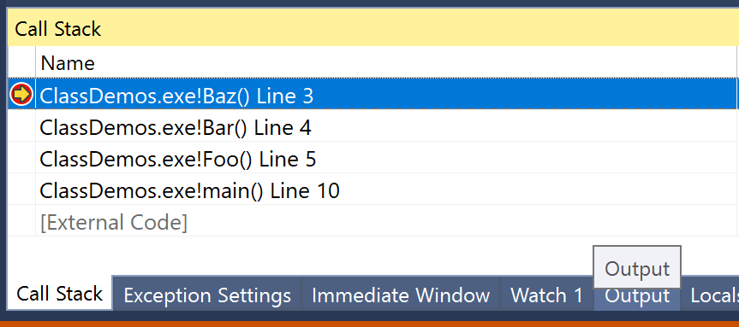
Call Stack in an IDE
In Visual Studio, while debugging: Debug->Windows->Call Stack

Slide 14
Stack Frames visualized
Local variables (if any)
void Bar(int count)
{
int *ptr = new int[count];
double pi = 3.14f;
OtherFunction(pi, ptr);
}
void Foo()
{
int x = 5;
int y = 10;
int z = 12;
Bar(10);
}
Frame for OtherFunction()
Previous function address
ptr
pi
ptr
Local Variables
Frame for Bar()
pi (3.14f)
Previous function address
count = 10
Parameter
x (5)
Local Variables
y (10)
Frame for Foo()
z (12)
Previous function address

Slide 15
Stack Frames visualized
Local variables (if any)
The size of these stack frames is determined by your compiler.
Frame for OtherFunction()
Previous function address
ptr
pi
The size of any variables declared, plus pointers to previous functions, plus the size of parameters
void Foo()
{
int x = 5;
int y = 10;
int z = 12;
Bar(10);
}
ptr
Frame for Bar()
pi (3.14f)
Previous function address
count = 10
x (5)
y (10)
Frame for Foo()
z (12)
Previous function address

Slide 16
Stack Pointer
Local variables (if any)
Stack pointer
Frame for OtherFunction()
A stack pointer indicates where the current stack frame resides, in stack memory
Previous function address
ptr
pi
As functions are called (or as they end), this pointer moves up or down—the stack “grows” or “shrinks”
ptr
Stack pointer
Frame for Bar()
pi (3.14f)
Previous function address
count = 10
x (5)
Moving this pointer is very fast, and is NOT the same as allocating dynamic memory with the new keyword
Stack pointer
y (10)
Frame for Foo()
z (12)
Previous function address
The stack pointer points to the “start” of the stack frame

Slide 17
Stack memory allocations may be reversed
main()
High Memory Addresses
We may think of a stack as growing “up” (i.e. stacking books)
Initialize()
In practice it MAY be the opposite: first frames on the stack are in higher memory addresses
LoadModels()
LoadEnvironmentModels()
Subsequent frames are added to lower addresses
Lower Memory Addresses

Slide 18
Stack memory usage fluctuates over time
After a function terminates, any stack variables are still in memory… at least temporarily
Another function call DOES NOT allocate new memory, it just overwrites stack memory
Stack memory gets “churned” pretty quick as functions begin and end

Slide 19
Stack memory is limited
Depends on the operating system, possibly compiler settings
Typically small, only a few megabytes in size
You can still create a LOT of data in a few megabytes
1 megabyte can be ~250,000 integers, ~125,000 doubles
This can affect how you create objects in your code
Too much data on the stack? You can cause a stack overflow error

Slide 20
Stack Overflow
Too much memory allocated on the stack
Every variable occupies SOME amount of memory
Every function call occupies some amount of memory
It all adds up!
Recursion can easily cause a stack overflow
Some function calling itself endlessly until memory runs out

Slide 21
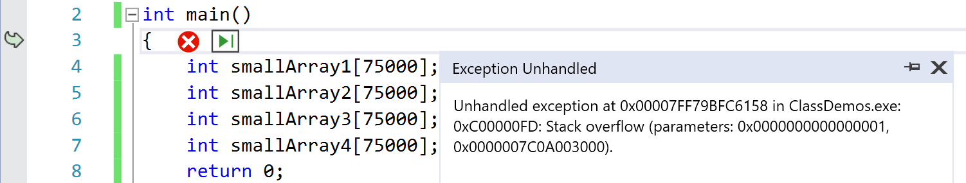
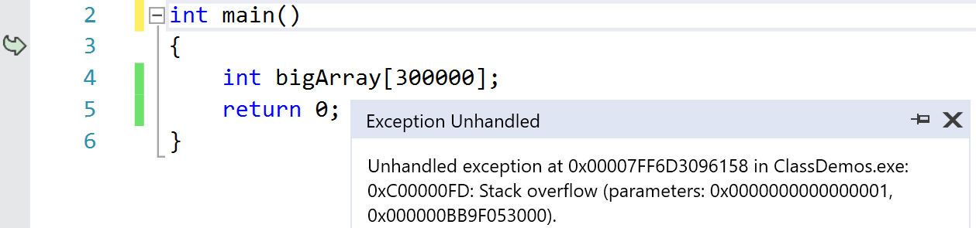
Stack Overflow
The number of variables doesn’t matter; only how much memory you allocate (or attempt to)
One single variable can be too large to create on the stack

Slide 22
Stack overflow from recursion
Try to use more stack memory than you have? Stack overflow error! (Like pouring water into an already full glass)
Factorial(int value = -2)
Error: Stack overflow!
Stack Memory
Factorial(int value = -1)
Factorial(int value = 0)
int Factorial(int value)
{
return value * Factorial(value - 1);
}
int main()
{
cout << Factorial(5);
return 0;
}
Factorial(int value = 1)
Factorial(int value = 2)
Factorial(int value = 3)
Factorial(int value = 4)
Each function call goes onto the call stack, and takes up some amount of stack memory
Factorial(int value = 5)
main()

Slide 23
The stack is a small amount of memory
Factorial(int value = 2) Error: Stack overflow!
Stack Memory
int Factorial(int value)
{
int bigArray[1000];
return value * Factorial(value - 1);
}
void SmallFunction()
{
Factorial(5); }
int main()
{
SmallFunction();
return 0;
}
Factorial(int value = 3)
Factorial(int value = 4)
Functions which require a large amount of space (even temporarily!), on the other hand…
Factorial(int value = 5)
Use more space on the stack
Functions are typically small; a call stack might store dozens, or hundreds of stack frames
SmallFunction()
main()

Slide 24
What if you NEED large amounts of memory?
Then you dynamically allocate memory on the heap
This data is allocated on the heap instead of the stack
void SomeFunction()
{
int bigArray[10000];
// Do some stuff
}
void SomeFunction()
{
// 1. Allocate memory
int* bigArray = new int[10000];
// 2. Do what you need to do
// 3. Deallocate memory
delete[] bigArray;
}
Automatic storage
The variable bigArray is allocated on the stack (all function variables are), but it points to memory on the heap
Dynamic storage

Slide 25
Heap – Storage for long-term or large data
Sometimes called “free store”
The C++ standard doesn’t mention “heap” and “stack” anywhere
The C++ standard uses automatic and dynamic storage
Conceptually, the same thing:
Stack – automatic storage
Heap – dynamic storage
Heap memory is reserved, or allocated with new, and freed, or deallocated with delete
This is MUCH slower to allocate/deallocate than stack/automatic memory
Must be done in many cases, though

Slide 26
Heap and stack memory grow toward each other
main()
High Memory Addresses
Initialize()
LoadModels()
Stack allocations move toward the heap
LoadEnvironmentModels()
Unused memory
Heap allocations move toward the stack
Heap Memory
Lower Memory Addresses

Slide 27
Stack variables vs Heap variables
ALL VARIABLES IN A FUNCTION are on the stack
All dynamically allocated memory is on the heap
void Foo()
{
int x; // stack
int* ptr = &x; // stack pointer, pointing to memory on the stack float* ptr2; // stack
double* someDoubles = new double[25]; // someDoubles is on the stack
}
Pointer, on the stack
The memory it points to… on the heap

Slide 28
Heap/Free store – when to use it?
Long-term storage
Free store memory persists separate from the stack
Allocate memory in a function, that memory lives on
Use for large allocations
Not limited by stack size
Use for dynamic allocations
When you don’t know how much memory you need at compile time
Many programming concepts (data structures, design patterns) would not be possible without this

Slide 29
When does data “disappear”?
Stack-based variables get “deleted” when they go out of scope
When their function comes off the call stack
The space they once occupied will later be overwritten
Stack-based memory is suitable for temporary data or data which is no longer required after the creating function exits.
Create some variables to do some work, use them, then forget about them
Heap-based variables live on… “forever”
Until you delete them
Or, until the program is terminated (most operating systems will free up that program’s allocated memory)
Incredibly important
We’re writing simple programs so far… but what about a program that runs for hours? Days?

Slide 30
Recap
Stack
Heap
Short-term storage
Automatic memory – no new/delete required
Small in size
Functions and the temporary variables they use are placed on the stack
Stack overflow errors if you try to use more than you have
Long-term storage (or big object storage)
Dynamic memory – the programmer must allocate and deallocate
Large – essentially all the rest of your computer’s memory
Memory leaks can occur if not managed properly

